Slide 1
Chinook Database Analysis: Insights and Predictions(Data science capstone project
By
Nwadike Ijeoma Mary
aijayij@gmail.com@gmail.com
Date: 08-06-2025
Tool Stack: SQL, Python, Power BI

Slide 2
Outline:
Introduction
Data Overview
Business Analysis
Predictive Model
Insights & Recommendations
Conclusion

Slide 3
Introduction
About the Chinook Database:
The Chinook database simulates a digital music store environment. It contains detailed records of music tracks, albums, genres, customers, invoices, employees, and purchase transactions which represents real-world business operations of a media retailer.
Purpose of the Analysis:
To uncover actionable business insights and customer behavior patterns that drive revenue.
Additionally, to develop a predictive model capable of estimating Customer Lifetime Value (CLV), empowering the business to target high-value customers, optimize marketing strategies, and support data-driven decision-making.
.

Slide 4
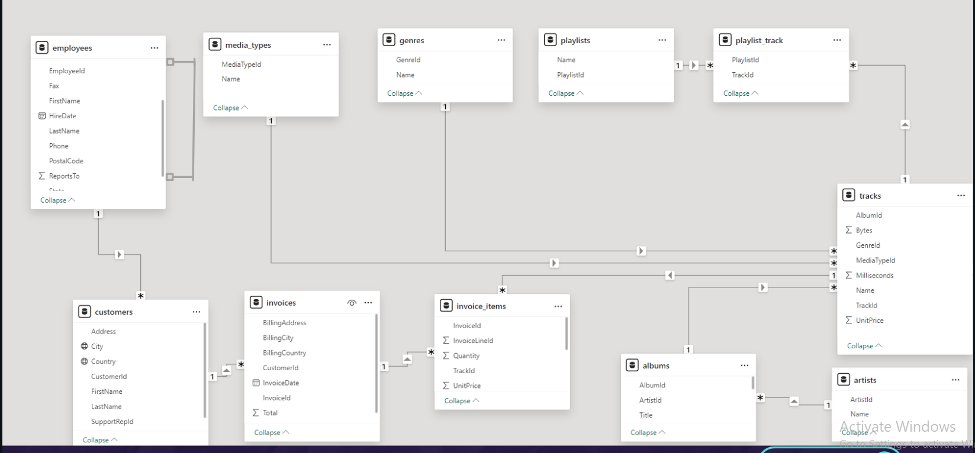
Data Overview
Data model
Tables used (e.g., invoices, customers, tracks, genres etc as shown in the model)
Tools used:
SQL: For querying and extracting insights.
- Python: For business and predictive analysis (CLTV modeling).
- Power BI: For interactive dashboard visualizations.

Slide 5
Key business questions
Who are the top-selling artists and how do their sales vary over time?
What customer segments exist based on purchase behavior?
Which genres are most popular and sales trend over time?
Which albums are purchased together(Market basket analysis)
How can we predict customer lifetime value?
Are there patterns in product purchases?

Slide 6
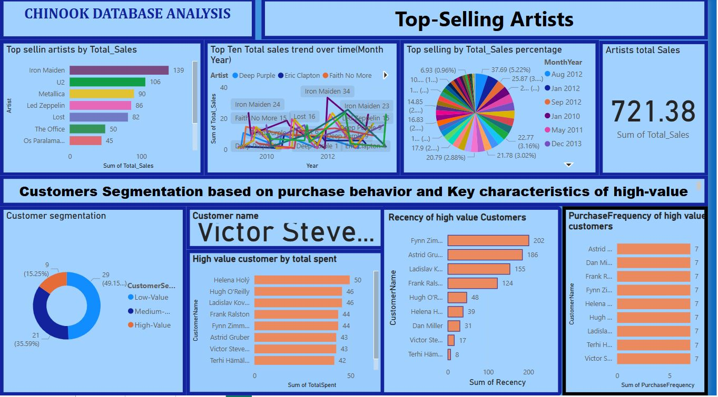

Slide 7
Top-Selling Artists, sales trend over time & Customer Purchase Patterns
Top-Selling Artists are Iron Maiden leads with 139 total sales,followed by U2 (106), Metallica (90), and Led Zeppelin (86)
Top-Selling Artists: Sales Trends
Diverse Sales Patterns: Artists show varied performance, anging from volatile spikes to consistently low sales.
Peak Performers: Iron Maiden: Major spikes (Dec 2009–Jan 2010, Feb 2011) followed by sharp declines. U2: Intermittent highs, peaking in Aug 2010, Jul & Oct 2011. Metallica: Frequent sharp peaks (Aug & Dec 2010, Jul 2011).
Consistent Lows: Os Paralamas Do Sucesso & Deep Purple: Steady low sales throughout, with minor fluctuations.
. Gradual Growth/Surges:The Offices sales increase from Sep 2011, peaking around Nov 2011 into early 2012.Faith No More sales surge from Dec 2011, peaking around Feb 2012, then declining. Eric Clapton had Low sales generally, but distinct upward trend and peak Feb-Mar 2012.
Customer Segmentation Summary
49% are Low-value customers,36% are Medium-value,Only 15% are High-value (VIP-level)
Top customers based on total spent: Helena Holy, Hugh O'Reilly, Fynn Zimmermann.
Fynn Zimmermann is most recent ,Astrid Gruber and Dan Miller also highly active

Slide 8
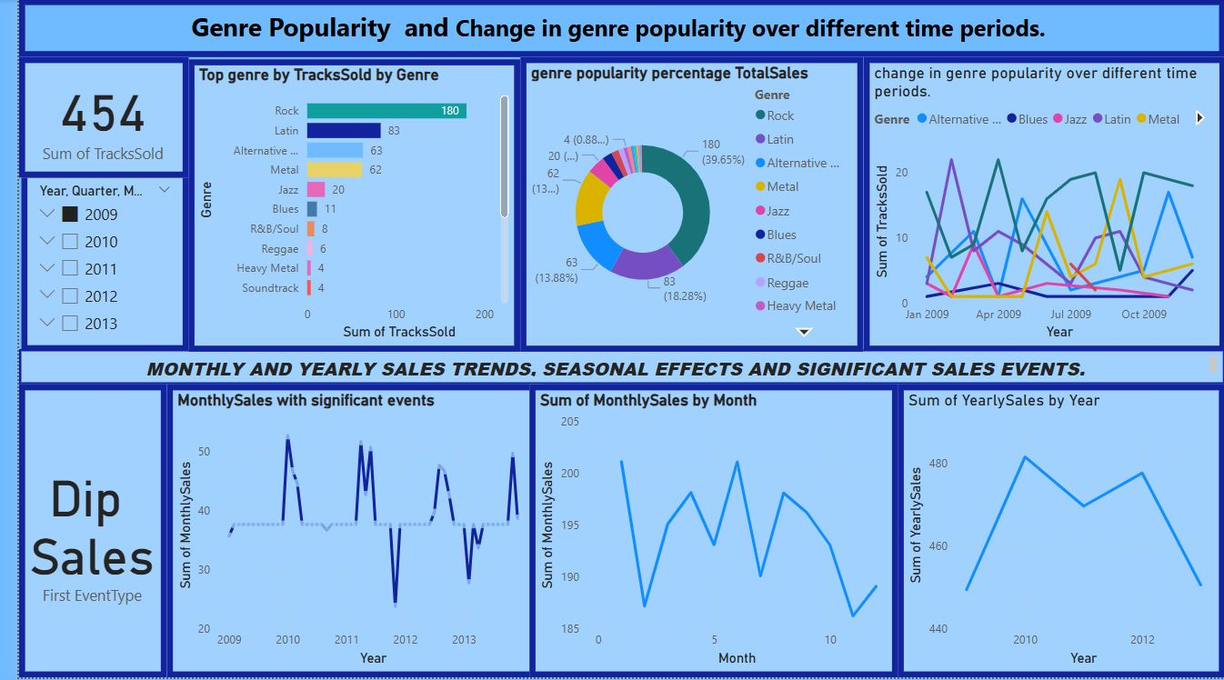

Slide 9
Genre Popularity & Sales Trends
Genre Popularity :
Rock is the most popular genre, with 39.65% of total tracks sold (180 tracks), significantly outperforming all other genres. Next Tier: Latin (83 tracks), Alternative (63 tracks), Metal (62 tracks), and Jazz (20 tracks) form the next tier of popular genres.
Genre Popularity Change : Rock shows fluctuating popularity throughout 2009, with peaks in April and October.
Alternative had notable popularity in early 2009 (Jan-Apr).
Blues had a distinct peak in July 2009.
Jazz sales were consistent but low.
Latin saw a surge in July and October 2009.
Metal showed peaks in April and September 2009.
Sales Trends Over Time
Monthly Sales: Frequent peaks and dips; no consistent upward/downward trend, largely event-driven.
Seasonal Effects: Peaks around January–February and May; dips around March. No month consistently dominates sales.
Yearly Trends:
2010: Peak year (~480 tracks sold)
2011–2012: Noticeable decline
2013: Signs of stabilization

Slide 10
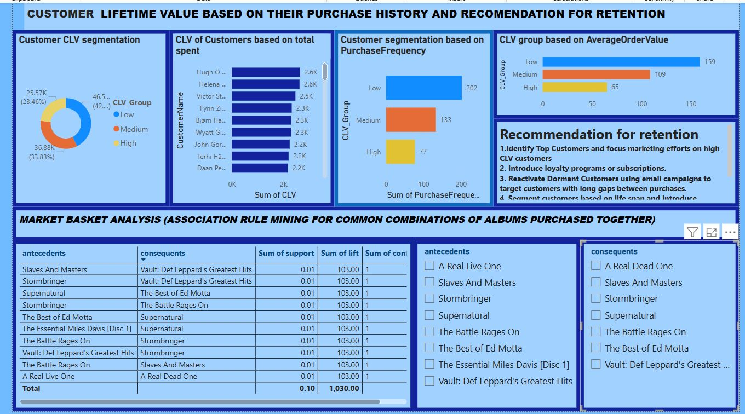

Slide 11
Customer Value & Market Basket Insights
CLV by Total Spent:
High-Value: 23.5% (42 customers)
Medium-Value: 33.8% (~37 customers)
Low-Value: 42.7% (~26 customers)
Top CLV Customers: Hugh O'Connell, Helena, Victor S.
CLV by Purchase Frequency:
High: 77 customers
Medium: 133 customers
Low: 202 customers
CLV by Avg. Order Value:
High: 65 , Medium: 109 , Low: 159 customers
Retention Tips:
Target top spenders with loyalty programs
Re-engage dormant customers via campaigns
Segment marketing by behavior & lifecycle stage
Market Basket Analysis (Association Rules)
Goal: Discover commonly bought album pairs for cross-sell opportunities.
Top Album Pairings:
Slavery and Masters ↔ Stormbringer
Suprematurnal ↔ The Best of Ed Motta
The Battle Rages On ↔ Stormbringer
Miles Davis [Disc 1] ↔ Suprematurnal
Def Leppard’s Hits ↔ The Battle Rages On
A Real Live One ↔ A Real Live Dead One
Recommendations:
Bundle frequently paired albums
Use “Frequently Bought Together” suggestions
Optimize placement & promotions based on rules

Slide 12
PART 2: Predicting Customer Lifetime Value (CLV) in the Chinook Database
Objective: To build a machine learning model that predicts Customer Lifetime Value (CLV) based on historical sales, customer demographics, and transaction patterns.
CLV Modeling Workflow
Data Understanding
Explored Chinook database structure using SQL
Identified key tables and attributes for CLV
Data Extraction
Joined & extracted relevant customer, sales, and product data using SQL
Feature Engineering
Generated variables: Total Spend, Recency, Country, Top Genre, Email Domain, etc.
Data Preprocessing
Handled missing values, encoded categorical features, normalize as needed
Model Building
Splitted data into training/testing sets
Trained models: Linear Regression, Random Forest, Gradient Boosting
Evaluate with R², RMSE

Slide 13
Predictive Model Development for CLV
Models Trained (Jupyter Notebook):
Linear Regression: Baseline, assumes linearity
Random Forest: Captures non-linear patterns
Gradient Boosting: Advanced ensemble model
Features Used:
Country, Total Spend, Recency, Top Genre, Email Domain (engineered from Chinook data)
Model Performance:
Linear Regression performed best (R² = 0.31)
Only model with positive R²
Indicates strongest predictive accuracy for CLV

Slide 14
Conclusion: Strategic Insights & Business Impact
Comprehensive analysis of the Chinook database reveals key patterns in customer behavior, sales dynamics, and growth opportunities.
The Rock genre dominates sales, and high value customers contribute significantly to overall revenue, emphasizing their strategic importance.
Seasonal fluctuations suggest timing promotions for peak effectiveness.
Top-performing artists and frequently paired albums present strong opportunities for cross-selling and bundling.
Implementing targeted marketing, data-driven promotions, and CLV-based segmentation can enhance loyalty and revenue consistency.
Modeling Outcome: Linear regression delivers the most reliable CLV predictions (R² = 0.31), outperforming more complex models.

Slide 15
Recommendations
Prioritize High-Value Customers: Leverage CLV predictions (via linear regression) to identify and retain top-tier customers through personalized loyalty programs and exclusive incentives.
Genre-Focused Marketing: Maximize engagement and revenue by emphasizing high-performing genres such as Rock, Latin, and Metal in promotional strategies.
Stabilize Seasonal Sales: Mitigate off-peak periods (e.g., November, December, February) with timely campaigns, discounts, and special events to maintain consistent revenue flow.
Strengthen Artist Collaborations: Foster partnerships with top-selling artists (e.g., Iron Maiden, U2) to drive recurring sales and reinforce brand positioning.
Boost Cross-Selling Opportunities: Apply market basket analysis insights to develop bundled offerings and personalized recommendations, increasing average order value and customer satisfaction.

Slide 16
Thank You
Contact: aijayij@gmail.com

